Slide 1
Preparing
for
opportunity
Talkatora stadium
New delhi
© 2013 DewSoftOverseas Pvt. Ltd. All Right Reserved.

Slide 2
The best time to join dewsoft was….
13 years ago
No Competition
Big Untouched Market
Unlimited Potential
Easy Recognition
Would have been a Crown Jewel by Now
© 2013 DewSoftOverseas Pvt. Ltd. All Right Reserved.

Slide 3
The Second Best time is
now
© 2013 DewSoftOverseas Pvt. Ltd. All Right Reserved.

Slide 4
Visions and goals
Almost all school children
in junior classes have an aim
to become something
Only 50% of HIGH school children
Still have a conviction
to become something
© 2013 DewSoftOverseas Pvt. Ltd. All Right Reserved.

Slide 5
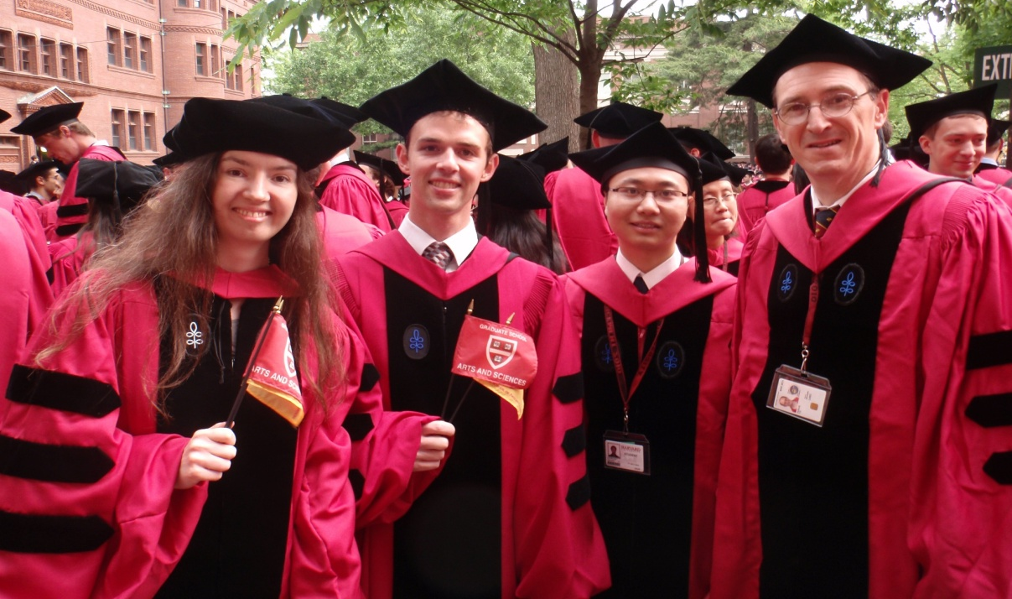
Class of 1960
Only 3% Wrote their Goals
20 years later
Total net worth of those 3% people was more than
combined
net worth of
the rest of the class
© 2013 DewSoftOverseas Pvt. Ltd. All Right Reserved.

Slide 6
Visions and goals
Goal is a short term target
It is measurable
It is definitive
It has a time limit
Common mistakes
I want to be successful
I want to buy a Car
I want to go for a holiday
I want to meet a film Star
because these
Cannot be Measured
Are Not Defined properly
Lack time limit
© 2013 DewSoftOverseas Pvt. Ltd. All Right Reserved.

Slide 7
Correct goals are like things to do list
I want a picture with Kumar Manish on the 11th April 2013
I have to see Lal Qila, India Gate, Rashtrapati Bhavan on 12th April 2013
I want to buy a 32” Samsung LED television by 15th June 2013
I want to buy a Bajaj Pulsar by 15th August 2013
I have to qualify Invitation for the Annual Party on 24th October 2013
I want to contribute to my family Rs.10,000/- per month by 15th Nov’ 2013
I want to go for a Thailand Tour for 4 -5 Days by 31st December 2013
We can always tell whether
They were achieved or not?
How much they cost?
And what action plans do
we need to achieve them?
Simple
clear
Well defined
Time framed
© 2013 DewSoftOverseas Pvt. Ltd. All Right Reserved.

Slide 8
Visions and goals
Vision
vision is a long term Goal
It is measurable
It is definitive
It has a time limit but usually 3 years and above
Common vision examples
I want to be Become a Crown Jewel by April 2018
I want to buy my Holiday Home in Goa worth Rs. 50 Lacs by April 2020
I want to become a Topaz by 2020
I want to get married before I turn 30
© 2013 DewSoftOverseas Pvt. Ltd. All Right Reserved.

Slide 9
goals
Don’t wander
A goal helps us focus and channelize our energies to help you achieve
It clears way for an action plan
It gives us control and direction for the way ahead
tips
Make small achievable Goals
Write them, Read them everyday, M+E
List your strengths
Admit your weaknesses
Create an Action Plan
Get knowledge and Skills as required
Discuss your plan with Seniors
Act as per your action plan
© 2013 DewSoftOverseas Pvt. Ltd. All Right Reserved.

Slide 10
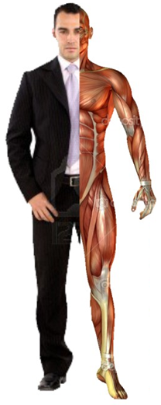
Target
Plan
Act
Review
Improvise
Achieve
Celebrate
Circle of life
Mantra To Achieve
© 2013 DewSoftOverseas Pvt. Ltd. All Right Reserved.

Slide 11
Target : walk 5 kms in 40 minutes in 5 weeks
Date: 11 april 2013 Start Date: 16/04/13
Mission | Target Time | Status | Remarks
2 kms in 15 minutes | 07 days 23/04/13 | Achieved, before time | Very Easy
3 Km in 25 Minutes | 14 days 30/04/2013 | Achieved, before time | Easy
4 Km in 35 Minutes | 21 days 01/05/13 | Achieved | Easy, Need to Drink
5 Km in 45 Minutes | 28 days 08/05/13 | Achieved | Tired, Need to Sleep
5 km in 40 minutes | 35 days 15/05/31 | Achieved | Yes.. Yes.. Party
© 2013 DewSoftOverseas Pvt. Ltd. All Right Reserved.

Slide 12
congratulations
celebrations
© 2013 DewSoftOverseas Pvt. Ltd. All Right Reserved.

Slide 13
Make your list of Goals Now..
live it
Everyday
Mission | Price | Date line | Status | Remarks
Pulsar Bike | 55,000 | 20 June 2013 | in progress
Swift Dezire | 500,000 | 15th Aug13
House Construction | 15,00,000 | 1st April 15
Mauritius Holiday | 90,000/- | 31st Dec 13
 |  |  |  | >p
Write it
Feel it
chase it
Live it
© 2013 DewSoftOverseas Pvt. Ltd. All Right Reserved.

Slide 14
Set your Sales Target
Mission | Target Time | Status | Remarks
2 sales in 7 days | 7 days ----/---/--- | Achieved | Easy
3 sales in next 7 days | 14 days ----/---/--- | Achieved | Easy
4 sales in next 7 days | 21 days ----/---/--- | Achieved | Easy
5 sales in next 7 days | 28 days ----/---/--- | In progress
6 sales in next 7 days | 35 days ----/---/---
7 sales in next 7 days | 42 days ----/---/---
8 sales in next 7 days | 49 days ----/---/---
© 2013 DewSoftOverseas Pvt. Ltd. All Right Reserved.

Slide 15
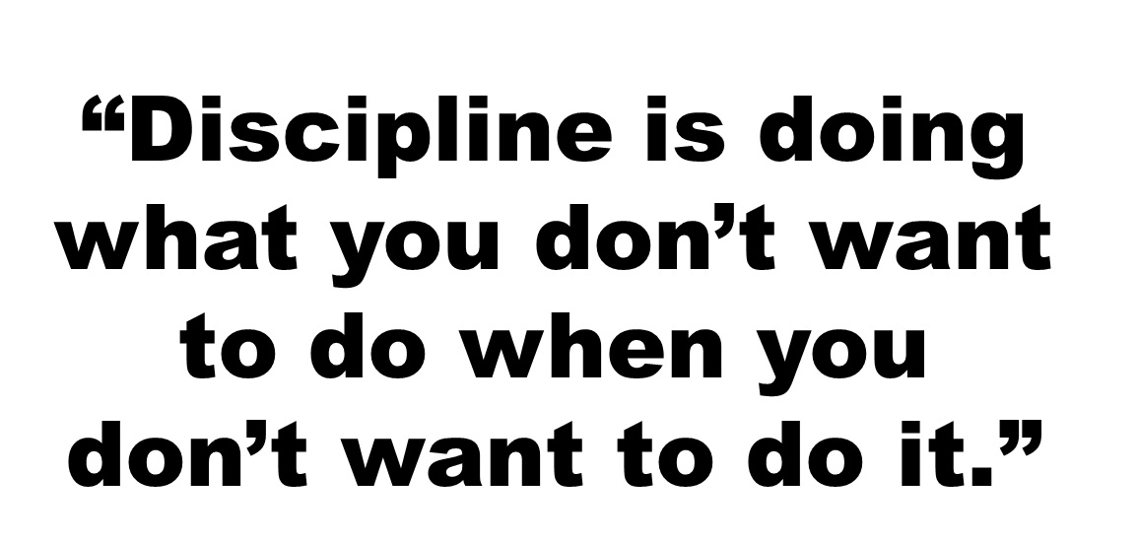
© 2013 DewSoftOverseas Pvt. Ltd. All Right Reserved.

Slide 16
Personal and professional Development
Target date: 4 weeks, start date : 15th April
Mission | Target Time | Suggested Plan | Remarks
Learn about the Product and the sales presentation | 7 days ----/---/--- | Watch Company DVDs Read Company Literature, Visit the company website, Meet senior channel partners, See a live seminar, Attend Training
Practice until perfect | 14 days ----/---/--- | Give at least 20 plans in a day for 7 days
Make that Call, to setup a meeting | 21 days ----/---/--- | Watch 4 Basics DVD Watch Product Demo DVD
© 2013 DewSoftOverseas Pvt. Ltd. All Right Reserved.

Slide 17
Personal and professional DevelopmenT contd-2
Target date: 4 weeks, start date : 15th April
Mission | Target Time | Suggested Plan | Remarks
Rehearse FAQs | 21 days ----/---/--- | Visit Company website Read FAQs
Understand the process of Delivery of Products, and its usage | 21 days ----/---/--- | Watch DVDs
Practice Dummy sales presentation | 21 days ----/---/--- | Watch Product Sales Presentation DVD Watch Presentation Techniques DVD
Make a sales presentation | 28 days ----/---/---
© 2013 DewSoftOverseas Pvt. Ltd. All Right Reserved.

Slide 18
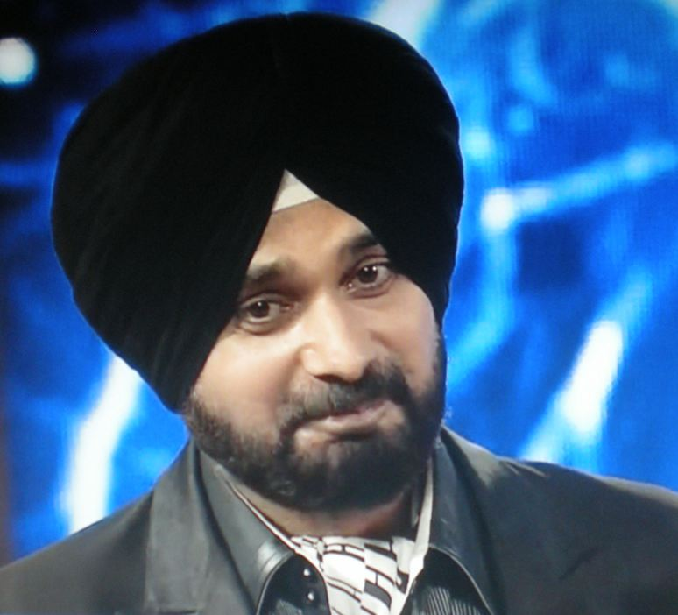
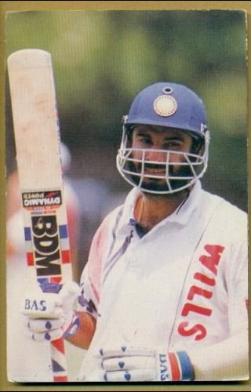
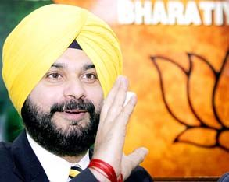
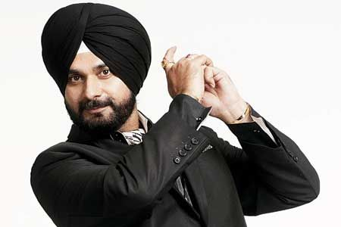
determination
H A R D .
W O R k
© 2013 DewSoftOverseas Pvt. Ltd. All Right Reserved.

Slide 19
You break Discipline when you choose
to ignore professional work
For
Just Hanging with friends
Attending Uncle’s Birthday
Spending 7 days in Cousin’s Marriage
Attending to Casual Illness
Feeling Lazy, Sleepy, Unwell
Finding Distance long
Making Excuses for nothing
Blaming Others
Always Running Late
Always Require follow up for your Own Work
© 2013 DewSoftOverseas Pvt. Ltd. All Right Reserved.

Slide 20
© 2013 DewSoftOverseas Pvt. Ltd. All Right Reserved.

Slide 21
© 2013 DewSoftOverseas Pvt. Ltd. All Right Reserved.

Slide 22
© 2013 DewSoftOverseas Pvt. Ltd. All Right Reserved.

Slide 23
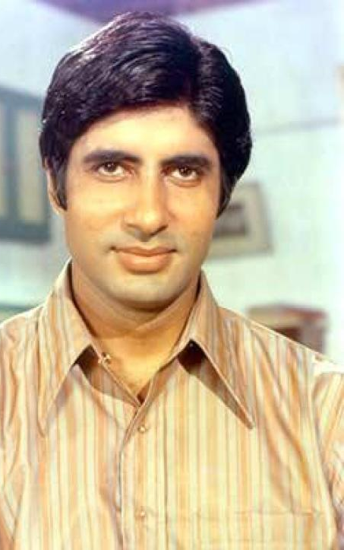
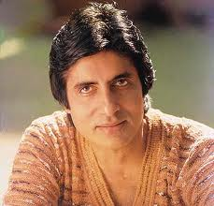
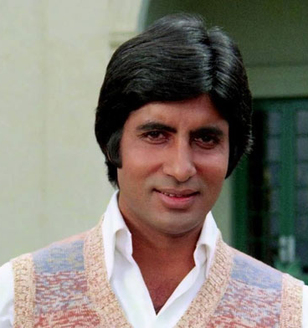
© 2013 DewSoftOverseas Pvt. Ltd. All Right Reserved.

Slide 24
© 2013 DewSoftOverseas Pvt. Ltd. All Right Reserved.

Slide 25
Laws of attraction: you get
Change your perspective and Actions
© 2013 DewSoftOverseas Pvt. Ltd. All Right Reserved.

Slide 26
It takes time
5 years
2 years
2 months
© 2013 DewSoftOverseas Pvt. Ltd. All Right Reserved.

Slide 27
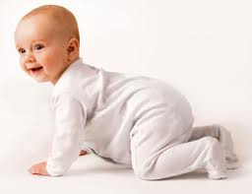
It takes time
12 years
12 months
© 2013 DewSoftOverseas Pvt. Ltd. All Right Reserved.

Slide 28
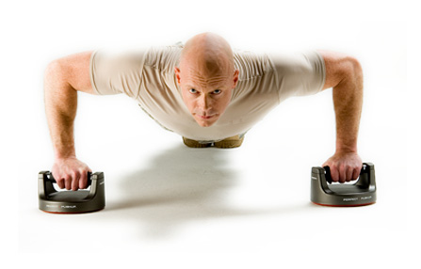
Perseverance = patience + persistence
© 2013 DewSoftOverseas Pvt. Ltd. All Right Reserved.

Slide 29
Everything is difficult before it becomes easy
© 2013 DewSoftOverseas Pvt. Ltd. All Right Reserved.

Slide 30
Express Gratitude
God | Parents | Family | Friends | Neighbors | Waiter
DewSoft | Upline | Team mates | Downline | Customer Care | Strangers
© 2013 DewSoftOverseas Pvt. Ltd. All Right Reserved.

Slide 31
© 2013 DewSoftOverseas Pvt. Ltd. All Right Reserved.

Slide 32
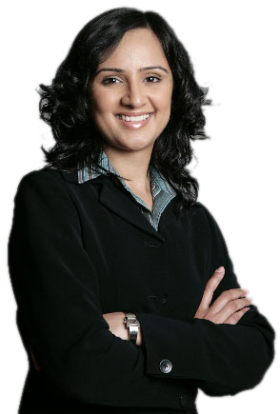
5 STAGES
Use The Books
Religiously
Watch the DVDs and CDs
Practice what you have learnt on workbooks
Use eLearning for Additional Help on All Subjects
Discover the New You
A CHANCE
TO
TRANSFORM
YOURSELF
© 2013 DewSoftOverseas Pvt. Ltd. All Right Reserved.

Slide 33
The world is your market
Students Housewives Working Executives Businessmen Institutions
Senior Citizens
Everyone
© 2013 DewSoftOverseas Pvt. Ltd. All Right Reserved.

Slide 34
Why dewsoft ?
4 Programs
to suit All Ages
and social groups
E-Learning
27,00,000 Crore
Industry Worldwide
World Class Product
Stability
Surety
Best Business
Direct Selling
120 Billion USD
100 Million People
Industry Worldwide
Industry Leader
No. 1 in INDIA
Amongst No.1,
around the world
20,00,000 Subscribers Worldwide
13 Years of Experience
Richest in the Industry
Excellent Management,
Educated, & Efficient.
More than 550 payouts
© 2013 DewSoftOverseas Pvt. Ltd. All Right Reserved.

Slide 35
Leadership through excellence
Education First
eLearning
Real time Academies
Concept First
Innovation and Development
More than 200 Copyrights
University Campus
Self Study Books, CDs, DVDs
SMS, Discussion forum and Live CHAT
Mobile Compatible Website
100% Inhouse Development & Control
Social Media Ready
Ecommerce Ready
ISO Certified Standards
© 2013 DewSoftOverseas Pvt. Ltd. All Right Reserved.

Slide 36
Recognition and rewards
The effort of the Institution or its Promoters is recognized by
Federation of Indian Chambers of Commerce, INDIA
Institute of Electrical and Electronic Engineers , USA
Associate for Computing Machinery, USA
International Society for Distance Learning, USA
American Institute of Architects, USA
Council of Architecture, INDIA
Delhi Chamber of Commerce, New Delhi, INDIA
Brampton Board of Commerce, Ontario, Canada.
Certified ISO 9001:2008 Education and Training for Real Time and eLearning environments.
© 2013 DewSoftOverseas Pvt. Ltd. All Right Reserved.

Slide 37
Thought for life…
I am what I THINK I am
I will become what I AIM to become
I will become what I WORK to become
I am responsible for the Good, and the Bad in my life
The others treat me the way I want them to treat me
If One Man Can do It, I can Do It.
I am the best
I am going to Reach My Goals
© 2013 DewSoftOverseas Pvt. Ltd. All Right Reserved.

Slide 38
Welcome to
Welcome to your new life
Together We Stand First
Together We Stand Proud
Together We Shall Win the World
© 2013 DewSoftOverseas Pvt. Ltd. All Right Reserved.

