Slide 1
WELCOME to
Programs 2013
Get ahead in life

Slide 2
Ontario, Canada
(November 2007)
Kathmandu, NEPAL
(May 2003)
THE INDIAN
MULTINATIONAL
New Delhi,
INDIA (December 2000)
AREA OF OPERATIONS
Software Development
Virtual Campus Education
Real Time Academies
Self Study Books & CDs
Upcoming University

Slide 3
what do we do??
Empower people with Knowledge, Skills, and Tools to make them capable of Contributing to the society
A chance
to transform
yourself
… and Realize Your Dreams

Slide 4
THE OPPORTUNITY

Slide 5
How do we do??
Nurture Individual Personalities, Instill them with Self Belief and Focus. Motivated them to Work and Achieve, by following successful people, who are like them

Slide 6
How do we do??
Unique Programs to Supplement Education, filling gaps and vacuum in our Formal Education making us Acceptable and COMPETITIVE as per Industry Expectations.
Dos And Don’t’s In Life
Nourish And Raise Knowledge And Awareness
Enhance Personal Development
Presentation And Communication Skills
Inculcate Self Explore And Resolution Skills
Build Self Confidence And Moral
Instill “I Can Do” Statement

Slide 8
5 PROGRAM STAGES
Use The Books
Religiously
Watch the DVDs and CDs
Practice what you have learnt on workbooks
Use eLearning for Additional Help on All Subjects
Discover the New You
A CHANCE
TO
TRANSFORM
YOURSELF

Slide 11
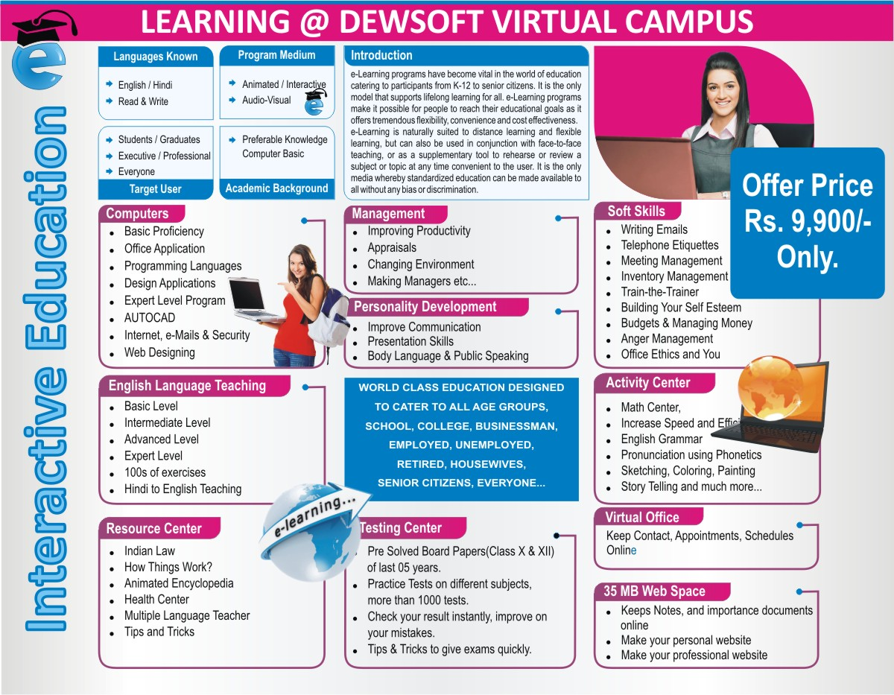

Slide 13
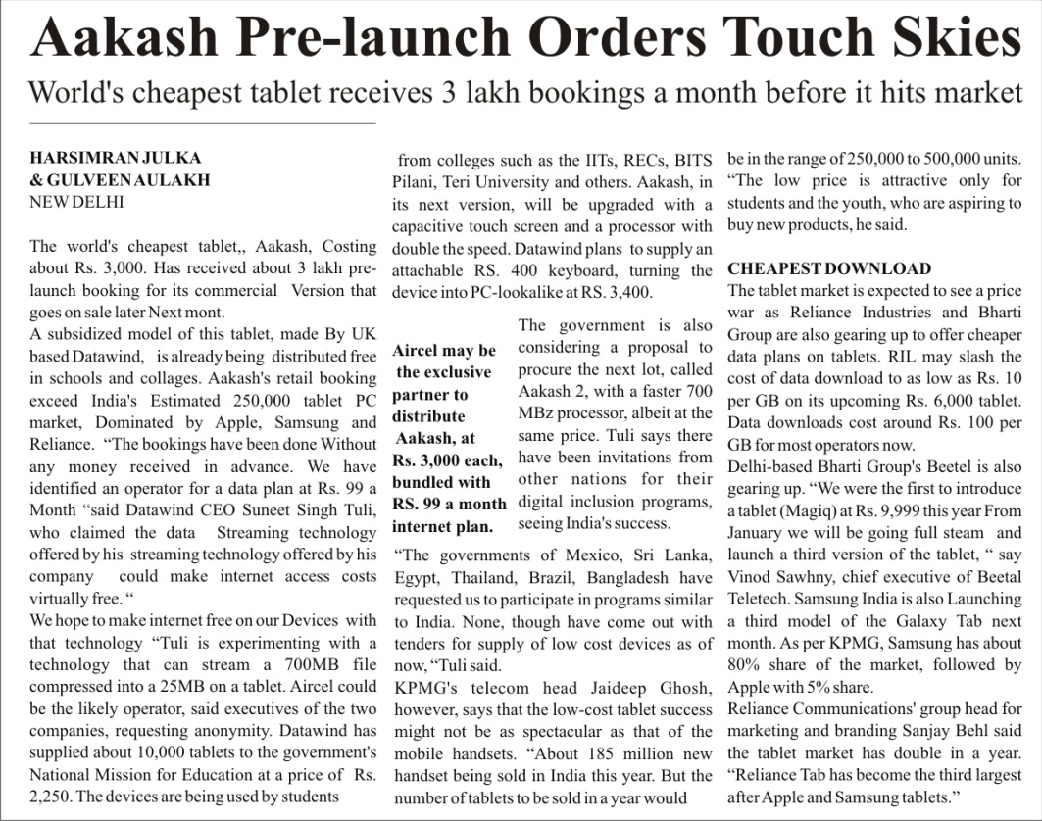
vital information

Slide 14
these figures tell us
INDIA is currently the 4th Largest Economic Power moving its way up to 2nd Largest Economic Power in the World.
Education is INDIA is way behind with the global standards.
20% INDIANs do not have any opportunity in their lives, no jobs, nothing to eat, they go hungry, another 30% have access to very little opportunities to earn livelihoods, together they are a staggering 50%
Crisis
Opportunity
Perspective

Slide 15
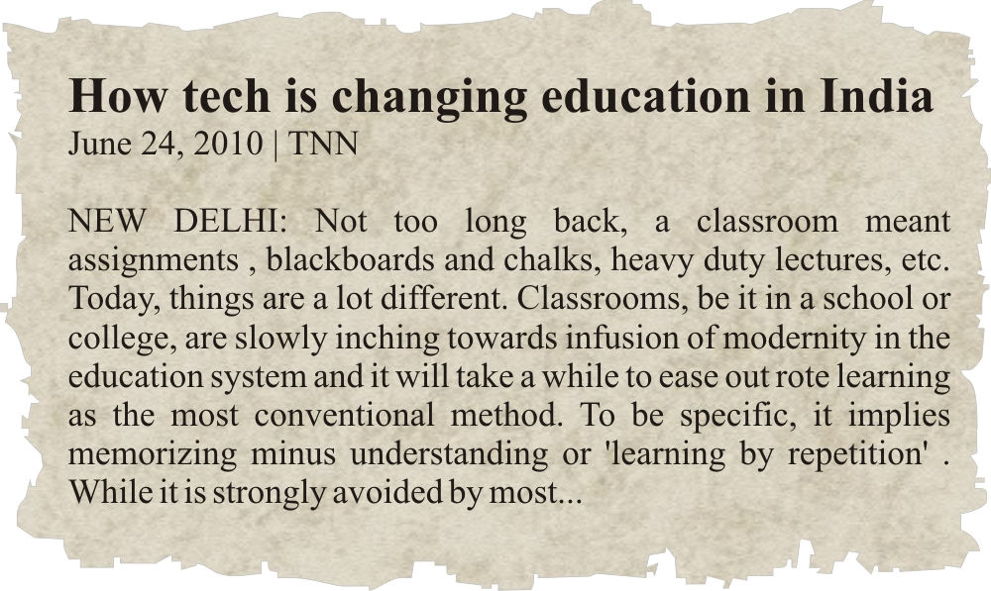
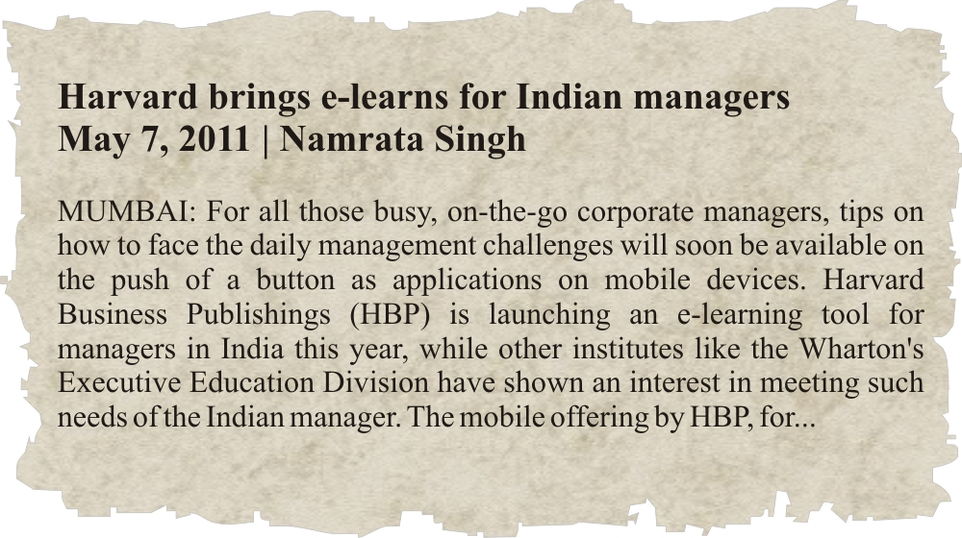
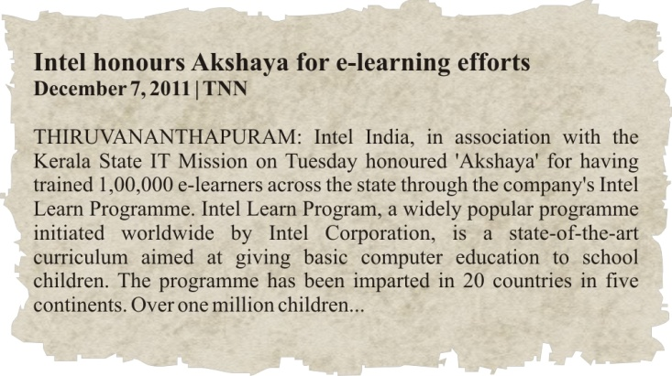
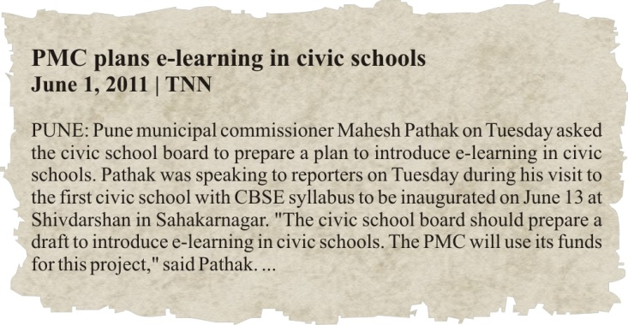
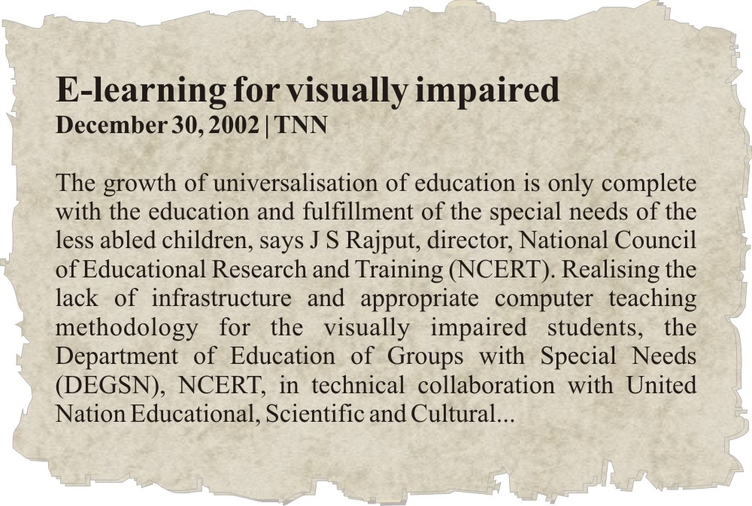
The industry highlights

Slide 16
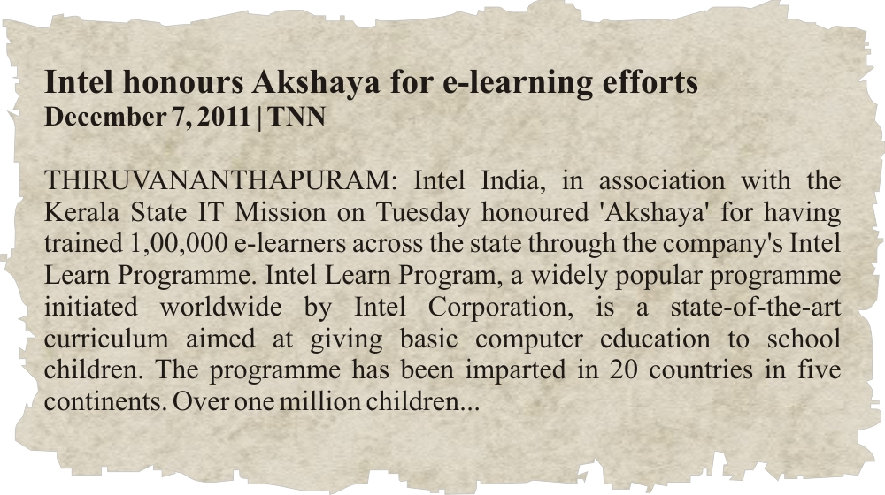
the industry highlights

Slide 17
There is an opportunity
INDIA is the place to promote eLearning and Small businesses that do not require Capital or Infrastructure.
It effectively terms “The Earn while you Learn Program” as the need of the hour for the INDIAN region, providing the best Opportunity to eLearn and eEarn.
50 Crore INDIANS
Need
DewSoft Products

Slide 18
The earn while you learn program
4 Great Programs to Cater to All Ages, Sections of Society
Your Own Business without any Capital or Infrastructure
Social Recognition
Lifestyle
Respect in Society
Established System of Trainings, Development and Support
One Program for All Your Needs.. Partners for Life..

Slide 26
The world is your market
Students Housewives Working Executives Businessmen Institutions
Senior Citizens
Everyone

Slide 27
One world one program: age no bar
Wrong questions
Who needs the product ?
Can I depend on dewsoft ?
is this for me?
will I be successful ?
right answers
there is always a sale, either you sell
your product, or buy his “no”
if I won’t someone else will.
there are no shortcuts to success
I must work hard and honestly

Slide 28
Why dewsoft ?
4 Programs
to suit All Ages
and social groups
E-Learning
27,00,000 Crore
Industry Worldwide
World Class Product
Stability
Surety
Best Business
Direct Selling
120 Billion USD
100 Million People
Industry Worldwide
Industry Leader
No. 1 in INDIA
Amongst No.1,
around the world
20,00,000 Subscribers Worldwide
13 Years of Experience
Richest in the Industry
Excellent Management,
Educated, & Efficient.
More than 550 payouts

Slide 29
Leadership through excellence
Education First
eLearning
Real time Academies
Concept First
Innovation and Development
More than 200 Copyrights
University Campus
Self Study Books, CDs, DVDs
SMS, Discussion forum and Live CHAT
Mobile Compatible Website
100% Inhouse Development & Control
Social Media Ready
Ecommerce Ready
ISO Certified Standards

Slide 30
Recognition and rewards
The effort of the Institution or its Promoters is recognized by
Federation of Indian Chambers of Commerce, INDIA
Institute of Electrical and Electronic Engineers , USA
Associate for Computing Machinery, USA
International Society for Distance Learning, USA
American Institute of Architects, USA
Council of Architecture, INDIA
Delhi Chamber of Commerce, New Delhi, INDIA
Brampton Board of Commerce, Ontario, Canada.
Certified ISO 9001:2008 Education and Training for Real Time and eLearning environments.

Slide 31
Welcome to
Welcome to your new life
Together We Stand First
Together We Stand Proud
Together We Shall Win the World

